Slide 1

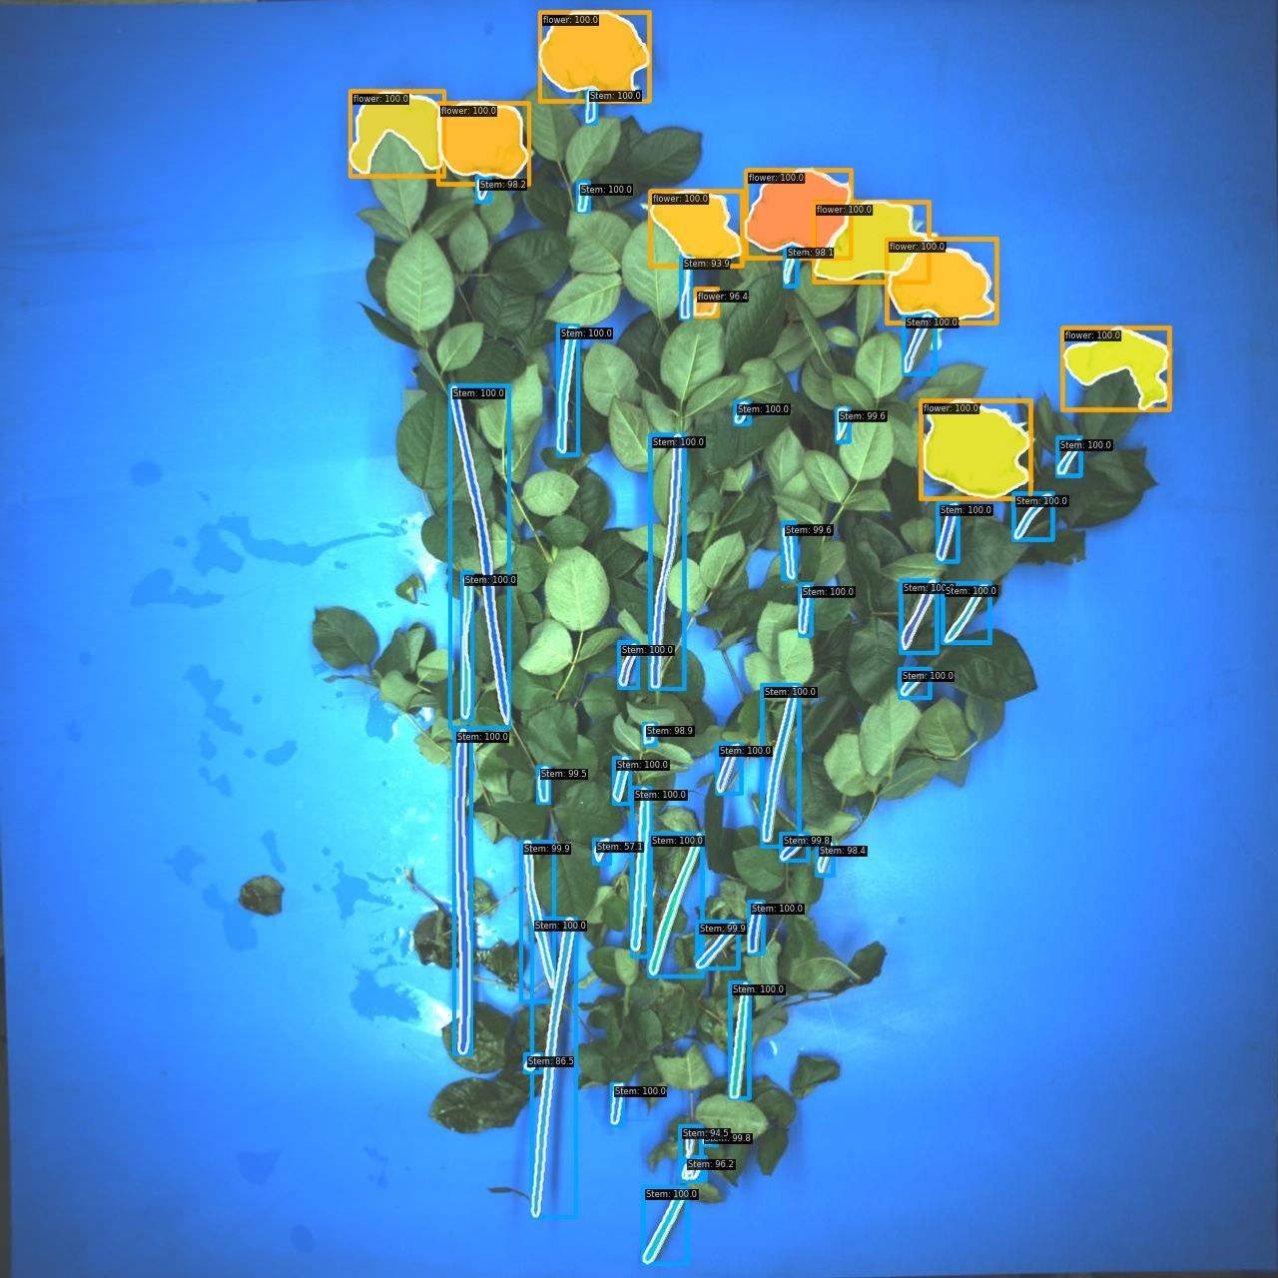
Instance Segmentation
Week 5 Hua Jiang

Slide 2
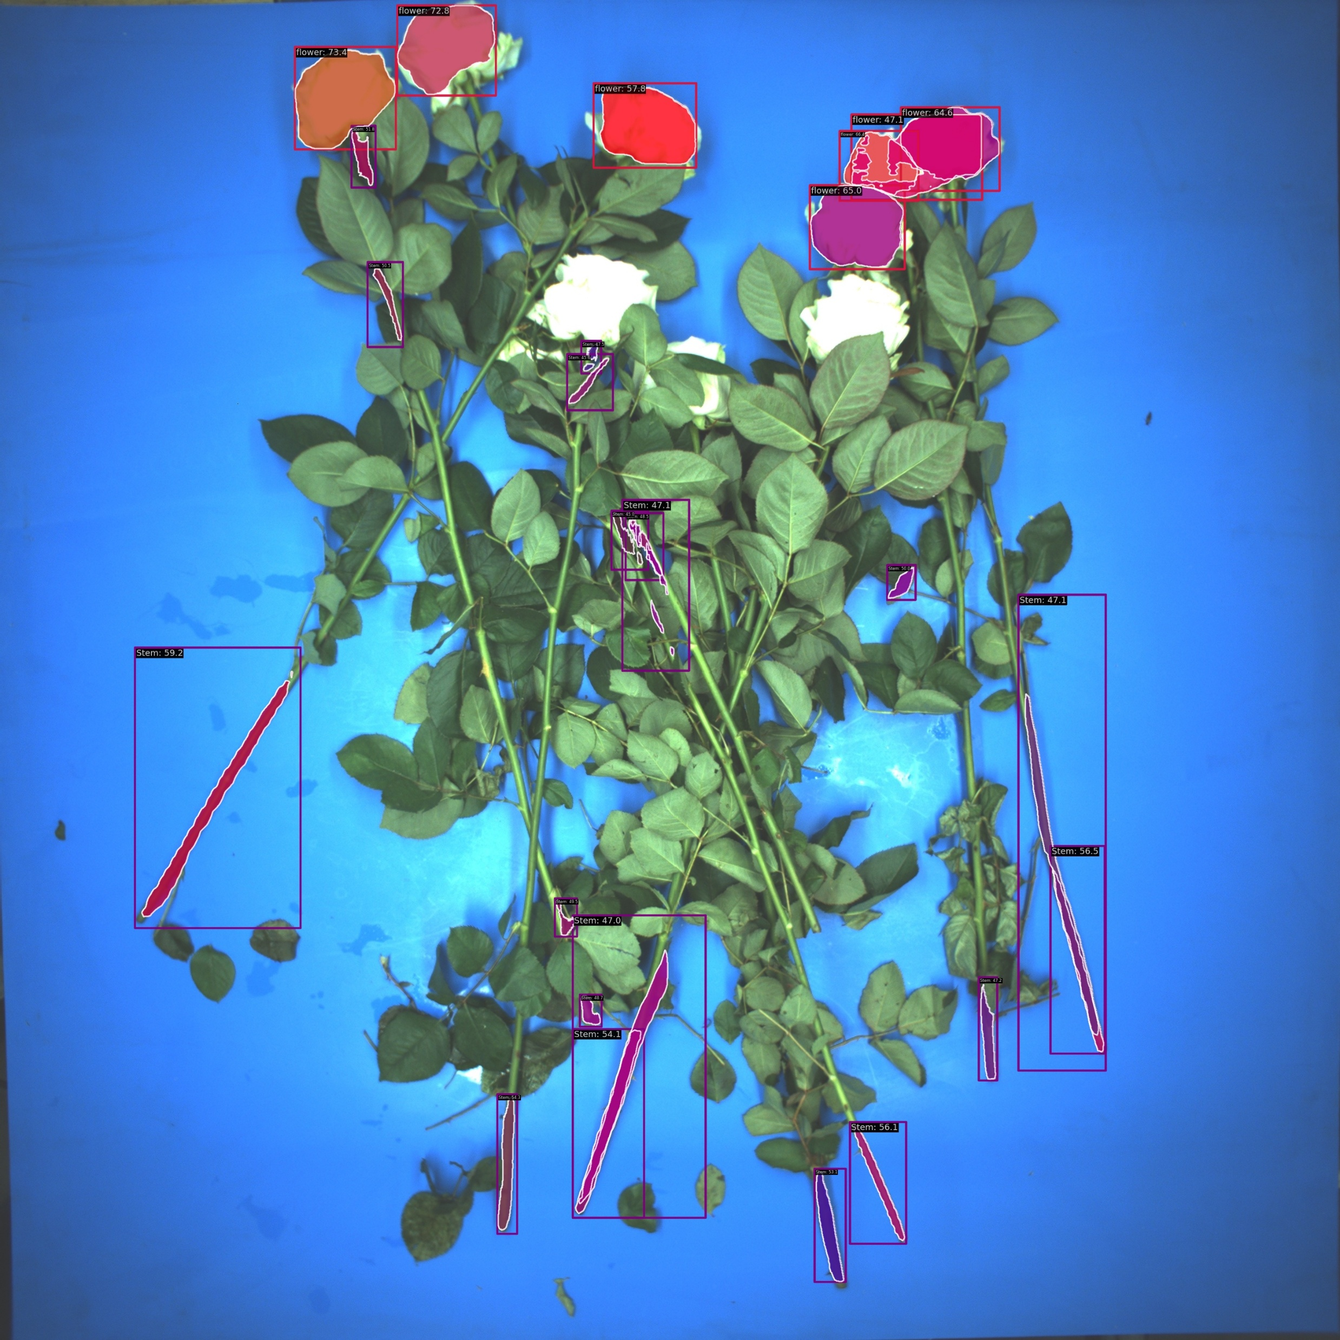
Model Improvement:
Data Augmentation, hyperparameters tunning, dataset expanding

Slide 3
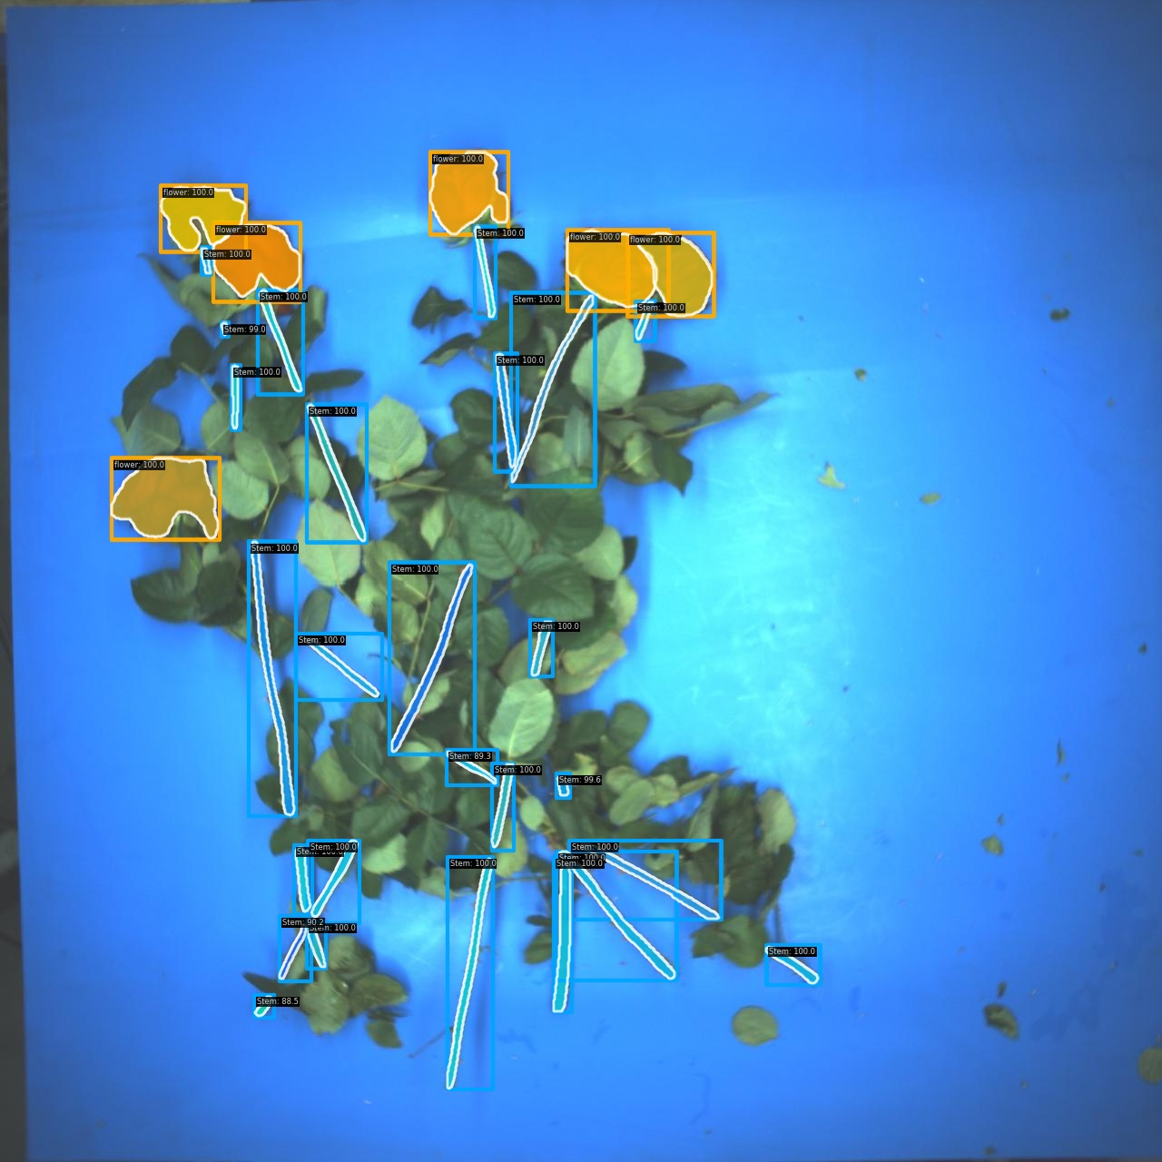
Able to detect and segments majority of the stems
100 raw images (75 training, 18 validation), 150 epoches.

Slide 4
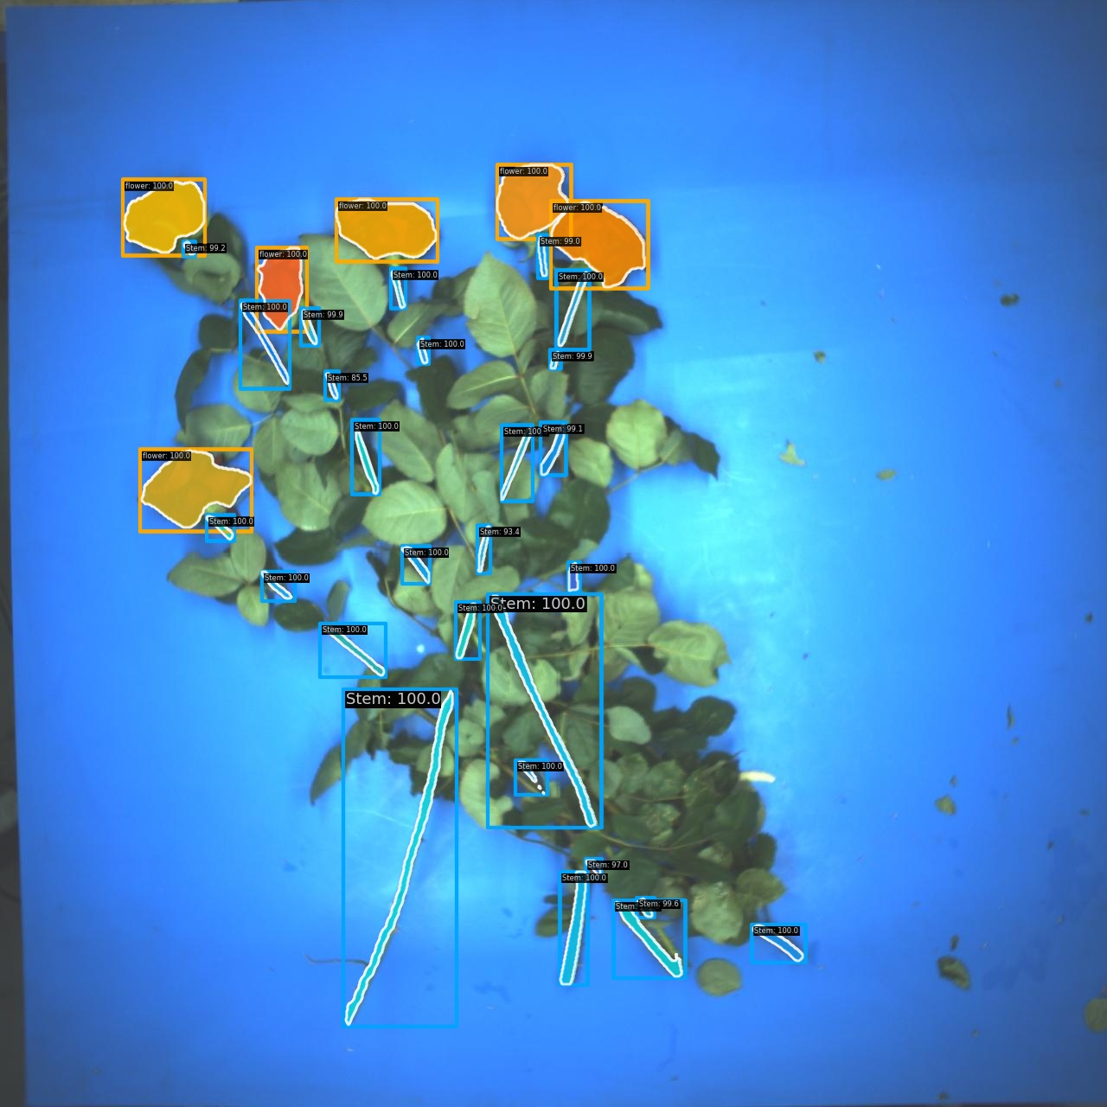
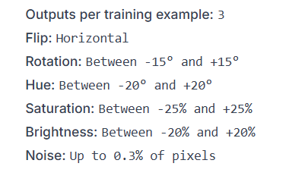
Expand the training data into 275 images with high variety
Various Data Augmentation Methods

Slide 5
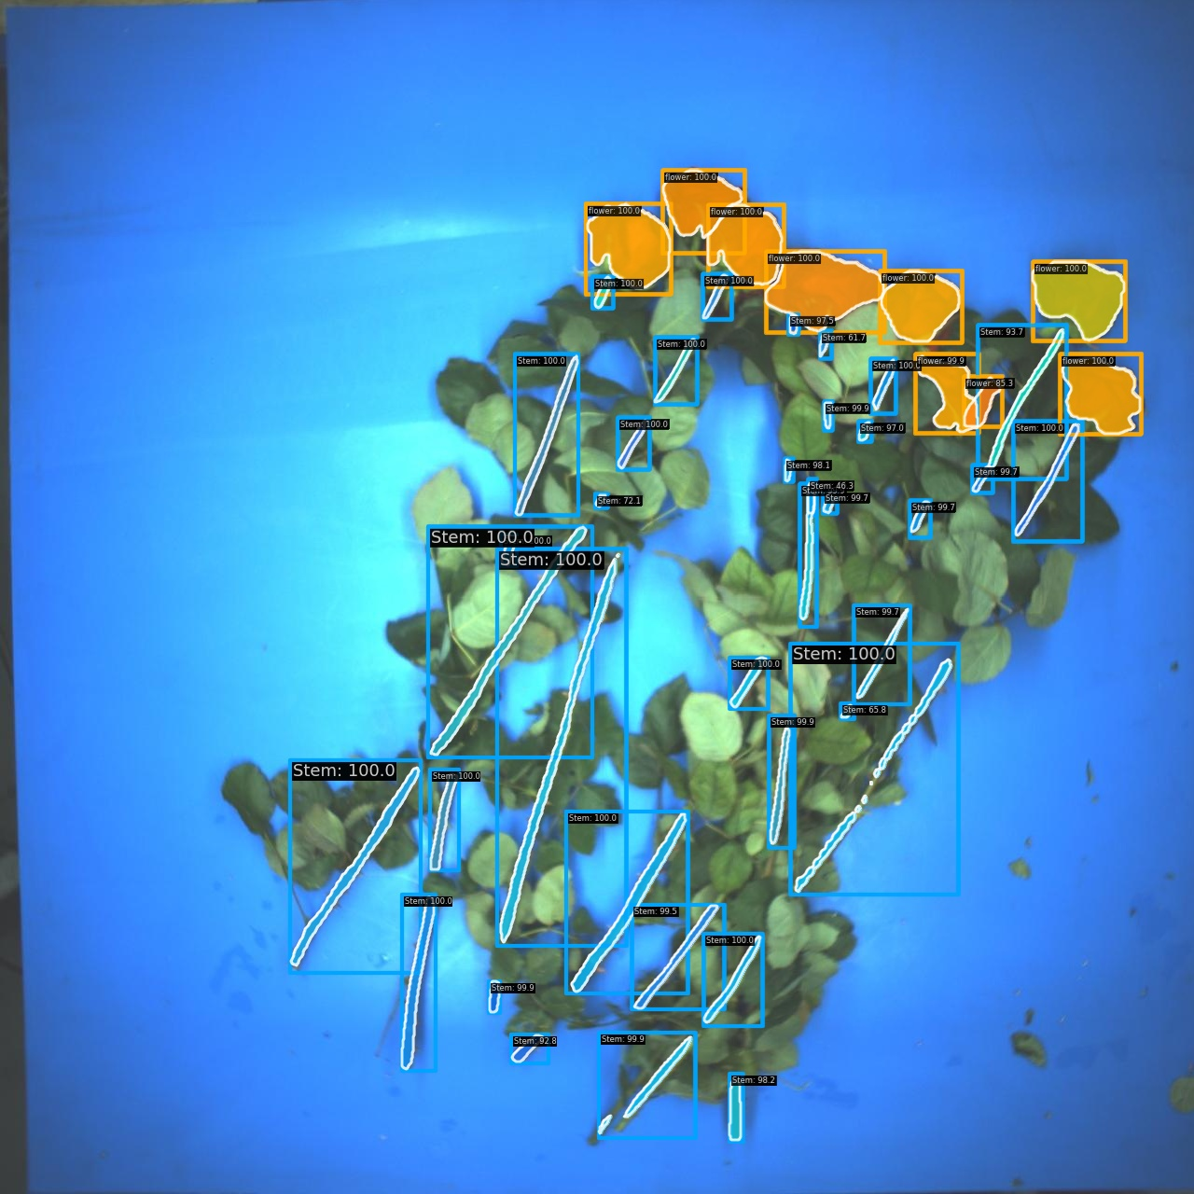
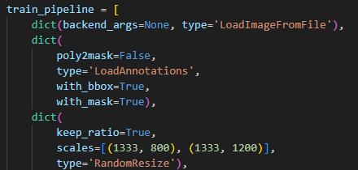
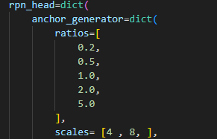
Random Resize: higher resolution
RPN：More rectangle ROIs and smaller anchors with higher IoU

Slide 6
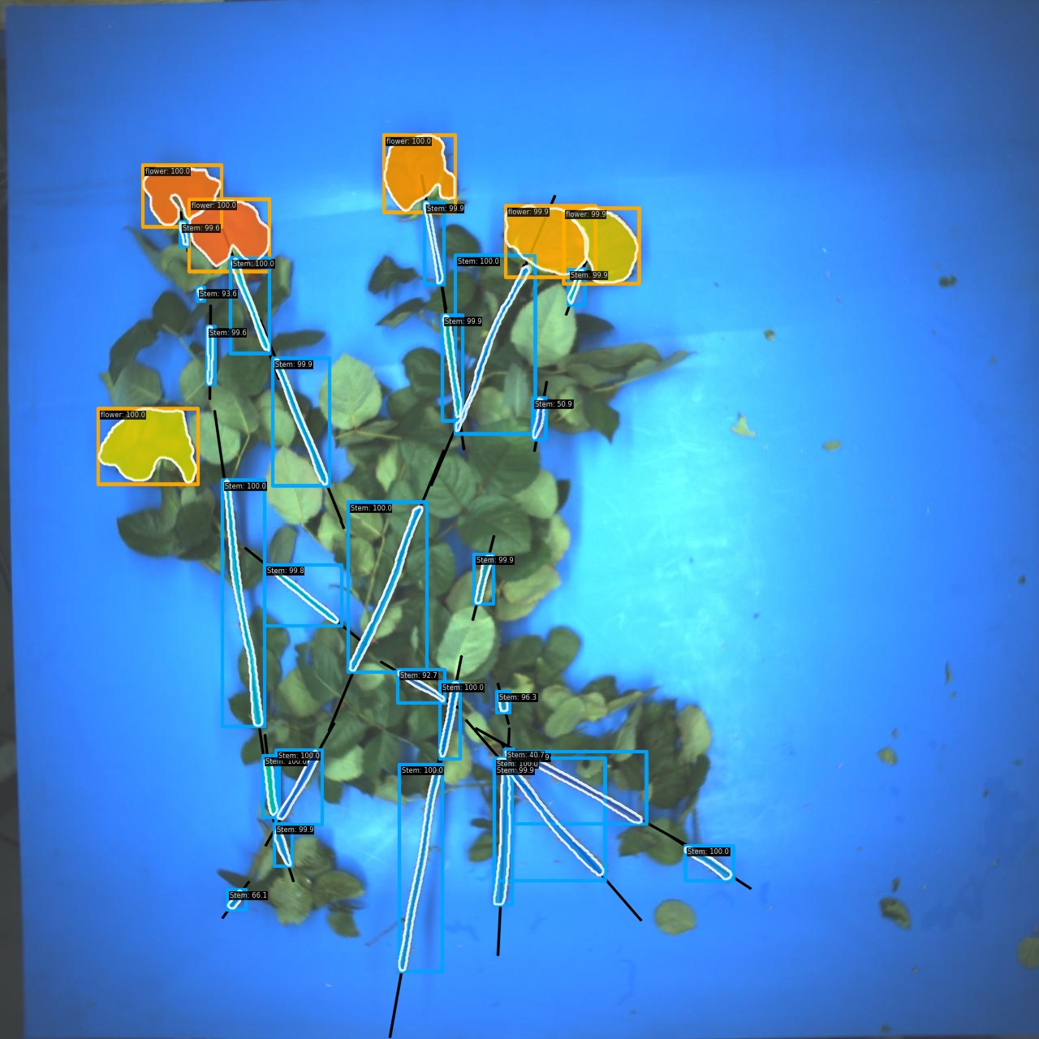
Taking this
1
2
3
Set flower as anchor, but hard to determine the orientation
-> Set stem as anchor to find the akin
4

Slide 7
Better to start from the top
1
2
3
4
Dont start from the bottom

Slide 8


Slide 9
1
1
2
2
3
3
4
4

Slide 10
Future Work:
Anchor and Stem line proposal
Stem line optimization

